Slide 1
AI Edge Devices

Slide 2
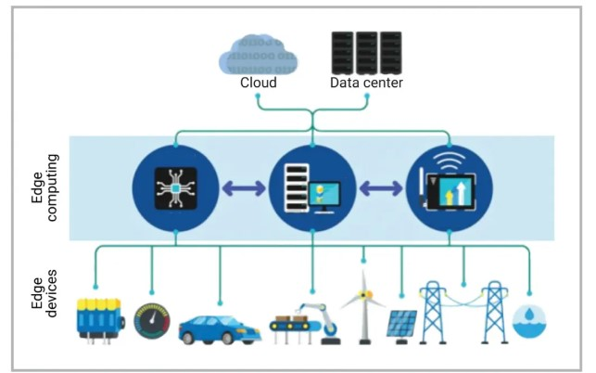
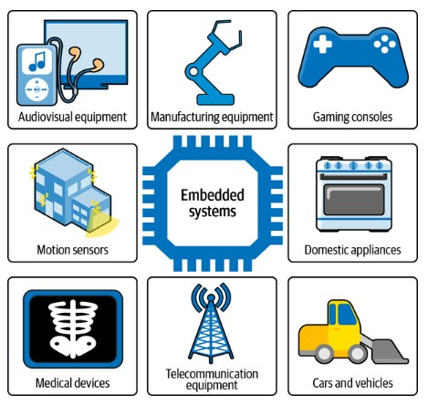
What is an edge device ?
Edge computing is processing data at the edge of a network. The edge of a network means either by the device itself or a local server, not the cloud.
In the AI domain, an edge device refers to a physical device located at the periphery of a network, equipped with sensors and processing capabilities that allow it to collect data locally and run AI algorithms on that data in real-time, without needing to constantly send information to a central cloud server; essentially, it performs data processing close to where the data is generated, enabling faster decision-making and immediate responses.
Key points about edge devices in AI:
Local processing: Edge devices process data on-site, minimizing latency by avoiding the need to send large amounts of data to a remote server. So low Bandwidth.
Real-time applications: Ideal for applications requiring quick reactions to changing conditions, like autonomous vehicles, industrial machinery monitoring, and smart home devices.
Low power consumption: Often designed to operate on low power, making them suitable for battery-powered devices like wearables and IoT sensors.

Slide 3
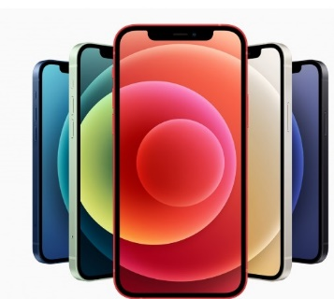
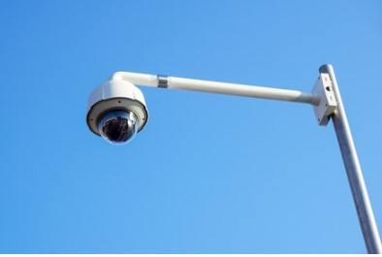
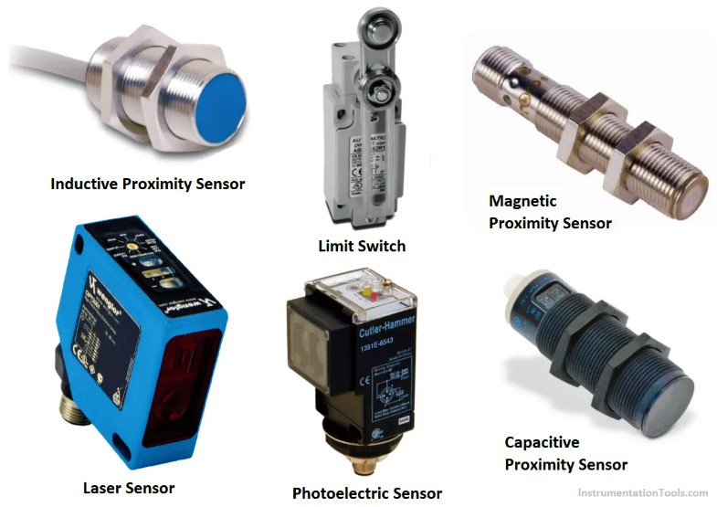
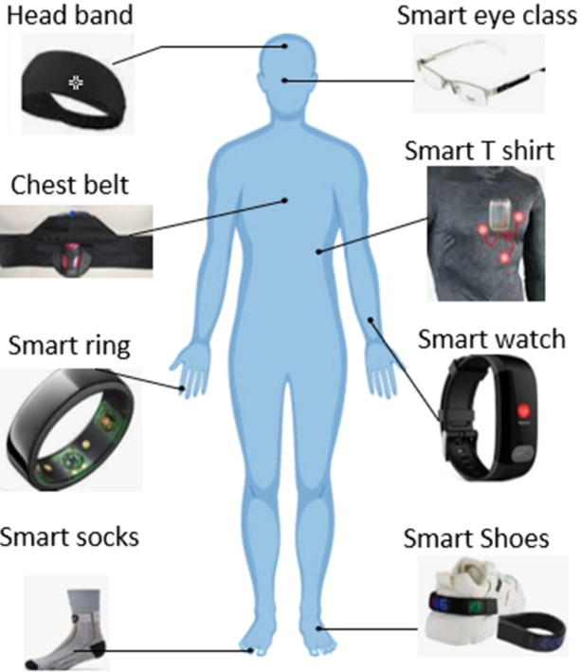
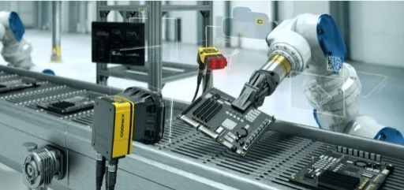
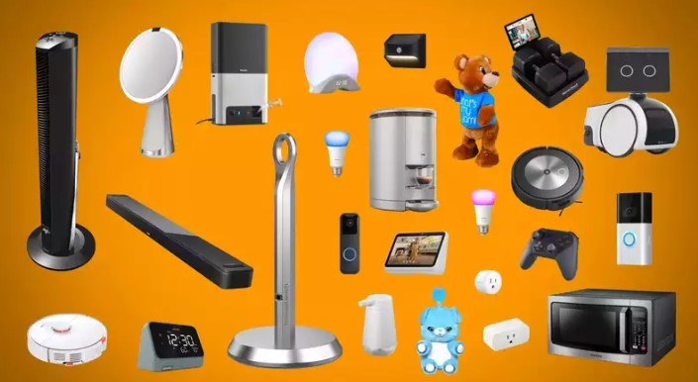
Examples of edge devices
Smartphones: Can run facial recognition or image analysis locally
Surveillance cameras: Analyze video footage in real-time to detect suspicious activity
Industrial sensors: Monitor equipment health and predict potential failures
Smart home appliances: Respond to environmental changes without needing constant cloud interaction
Wearable devices: Monitor health metrics like heart rate in real-time

Slide 4
Drawbacks of Edge AI
Limited hardware capabilities: Edge devices often lack the computational power and memory to handle complex machine-learning models.
Difficulty in model updates: Compared to a centrally managed cloud-based system which supports easier and remote updates, it is challenging to update, and maintain machine learning models across multiple edge devices.
Difficulty in accessibility: Edge AI systems may not provide the same level of universal access as cloud-based models.
Potential need for fog computing: For complex applications, replicating cloud-like capabilities on regional edge servers (fog computing) may be necessary. It adds another layer of infrastructure and management complexity.
Fog computing is a form of distributed computing that brings computation and data storage closer to the network edge, where many IoT devices are located. By doing this, fog computing reduces the reliance on the cloud for these resource-intensive tasks, improving performance and reducing latency

Slide 5
Edge Impulse (Web application): p1
No Coding Required: You don't need to be a coding expert to use Edge Impulse. Our platform provides a user-friendly interface that guides you through the process - this includes many optimized preprocessing and learning blocks, various neural network architectures, and pre-trained models and can generate ready-to-flash binaries to test your models on real devices.
Edge Computing: Your machine learning models are optimized to run directly on your edge devices, ensuring low latency and real-time processing.
Support for Various Sensors: Edge Impulse supports a wide range of sensors, from accelerometers and microphones to cameras, making it versatile for different projects.
Community and Resources: You're not alone on this journey. Edge Impulse offers a supportive community and extensive documentation to help you succeed.

Slide 6


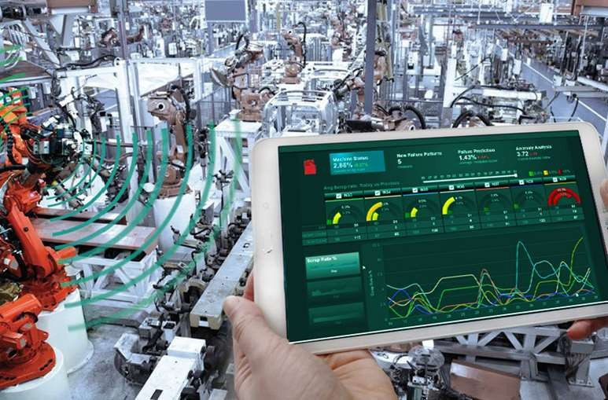

HANDS ON WITH EDGE IMPULSE

Slide 7

MACHINE LEARNING AND EDGE AI
Edge Impulse(Object Classification)

Slide 8
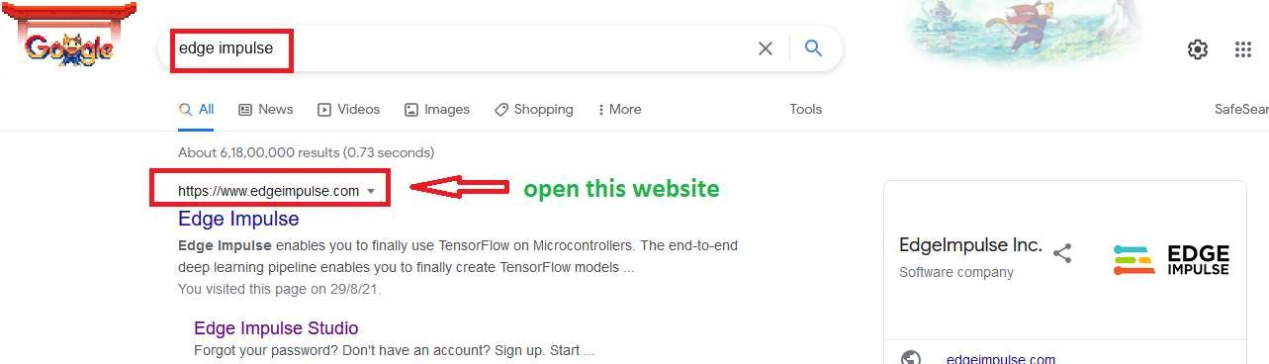
Open edge impulse website
www.edgeimpulse.com

Slide 9
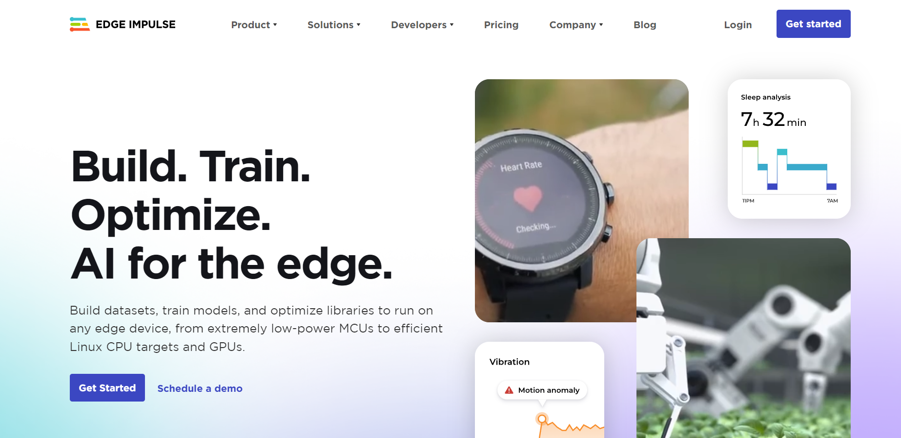
Sign up here

Slide 10
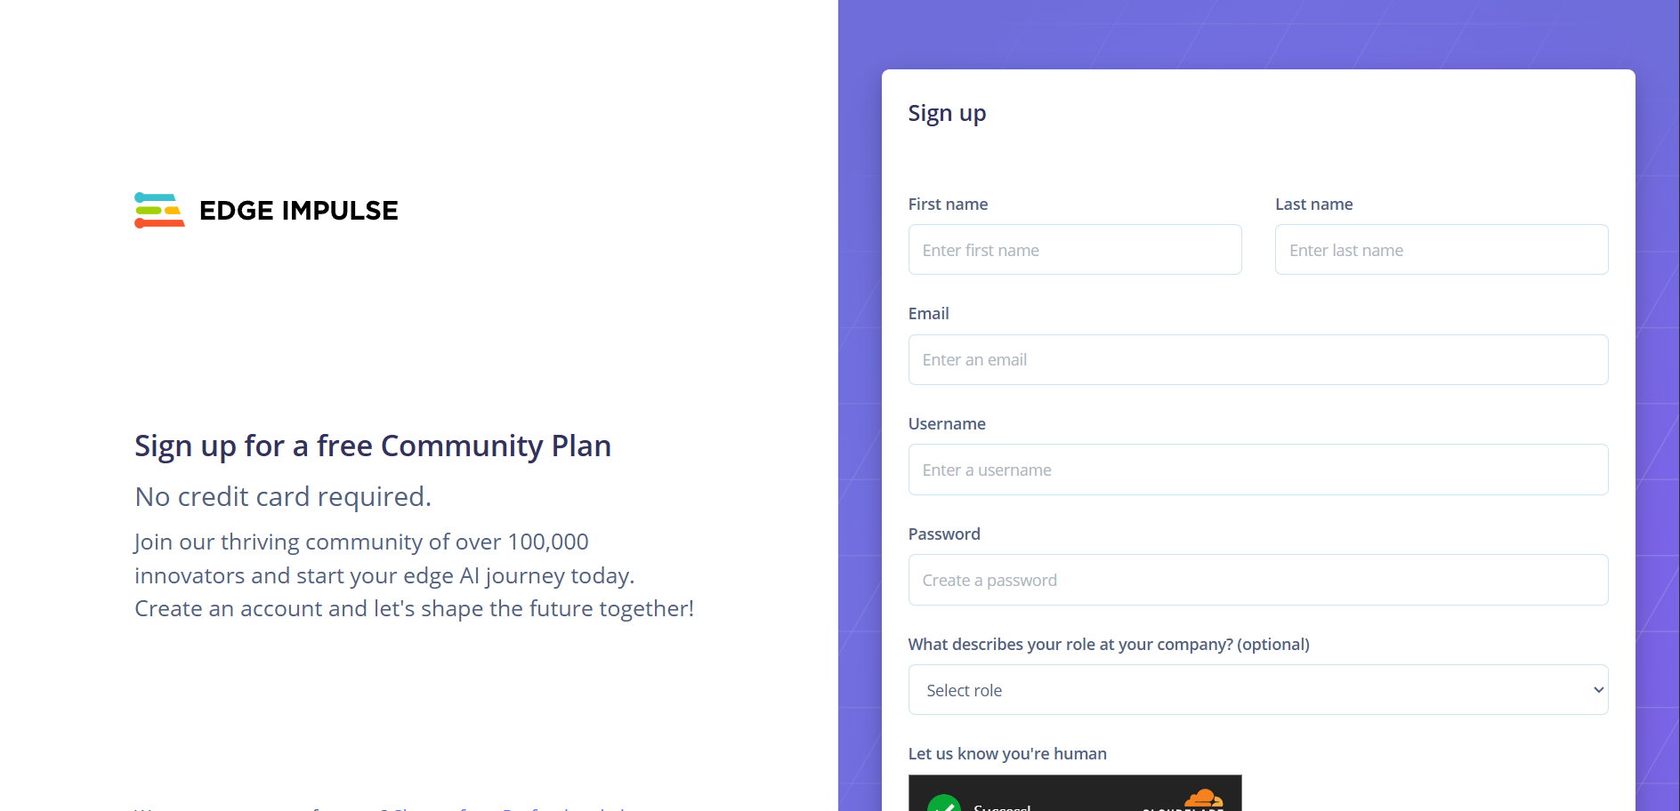
Fill the details: If having problems creating account, like getting 403 error, then use mobile to create an account

Slide 11
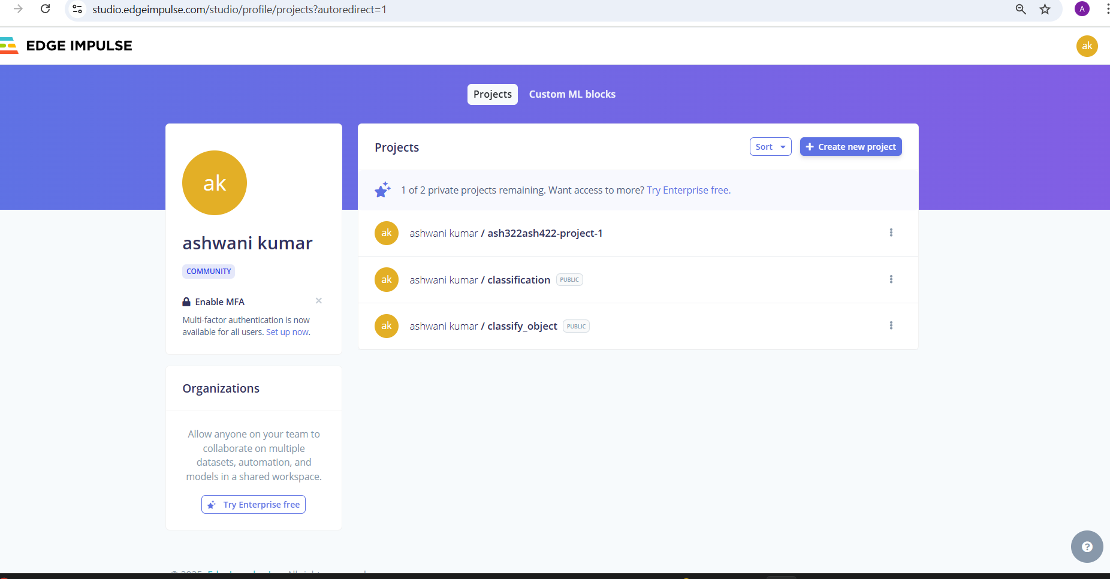
After sign-up successfully, click to build your first Project

Slide 12
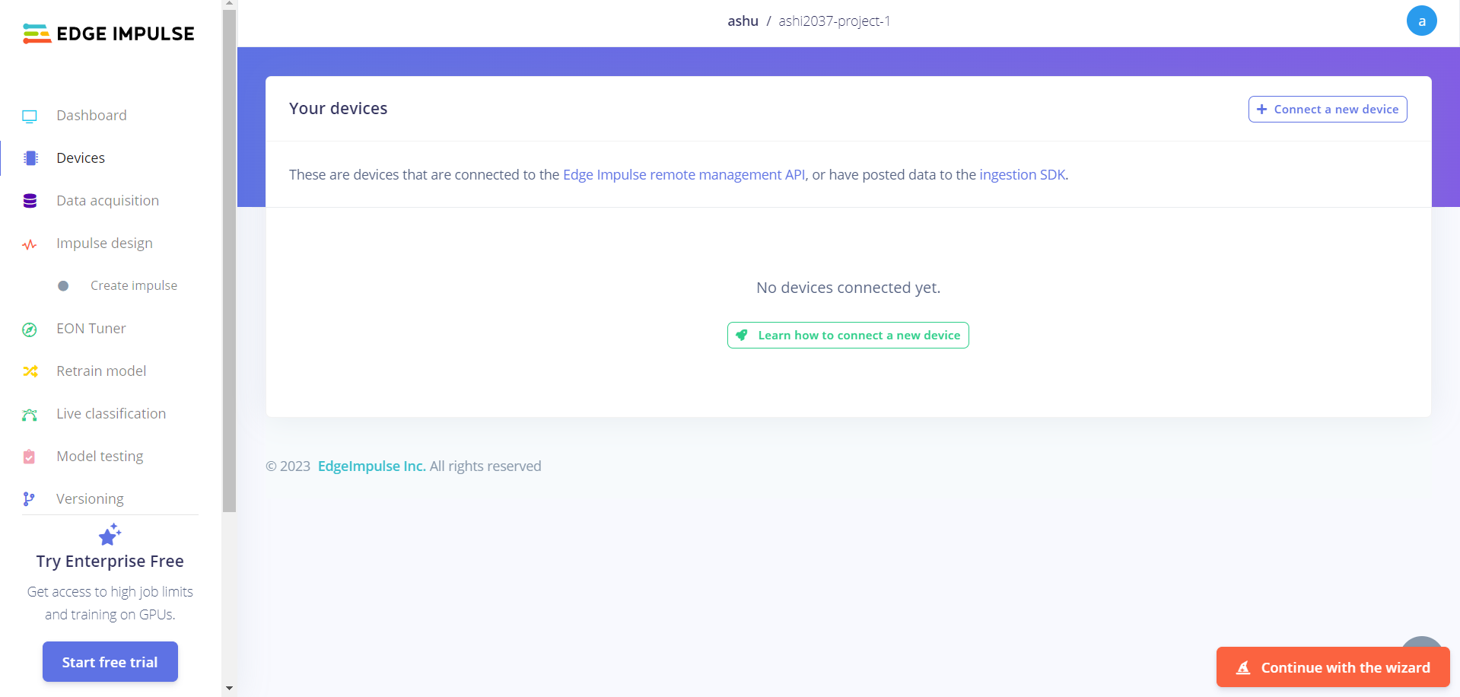

Slide 13
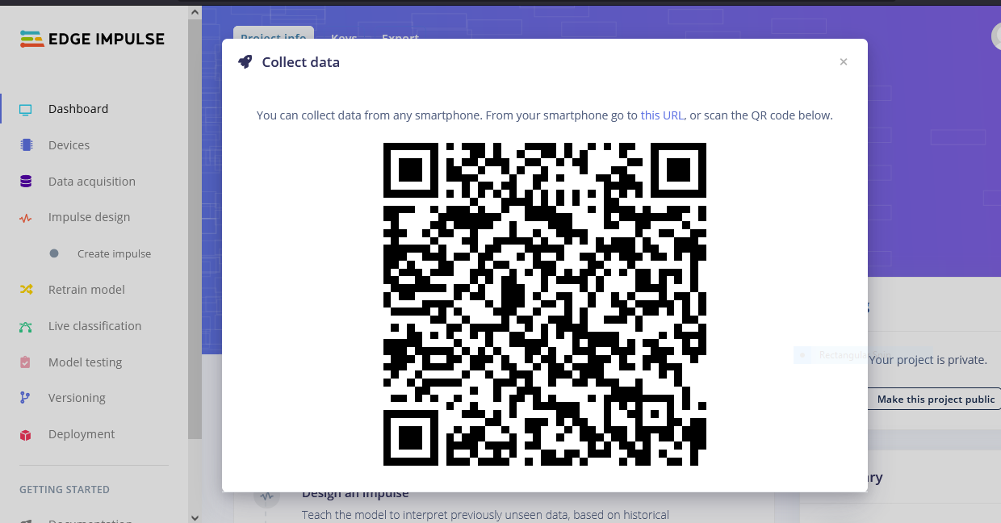
Scan QR Code With Mobile

Slide 14
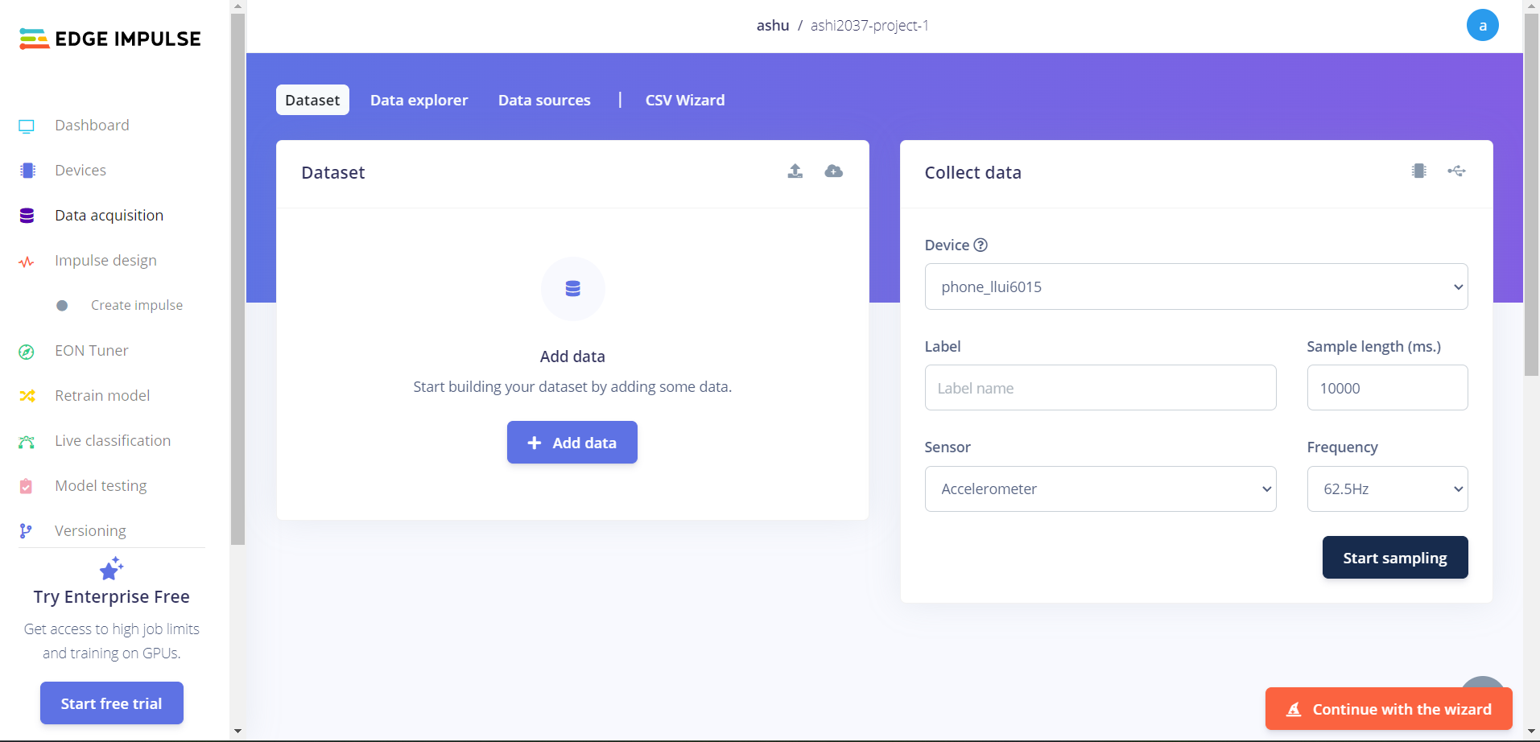
Now We Acquire Data

Slide 15
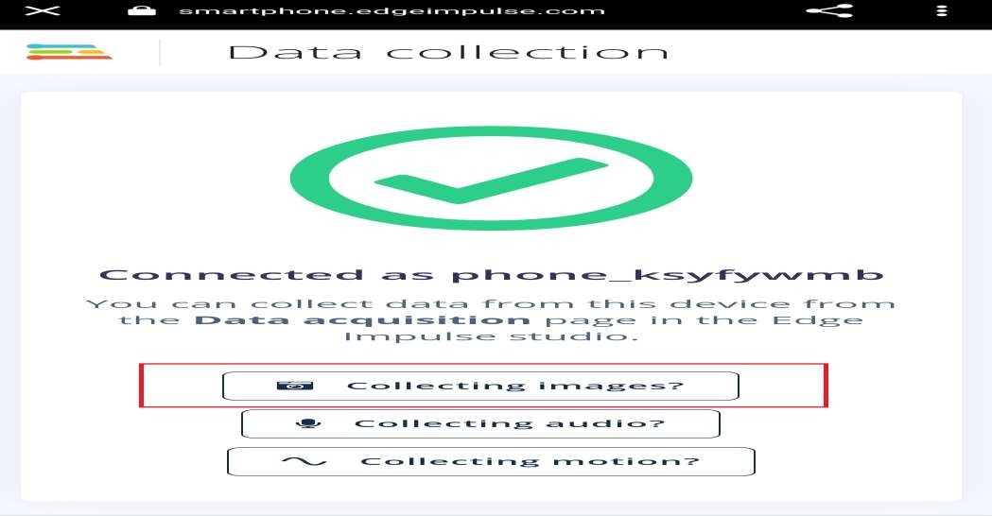
Click On Collecting Images In Your Mobile

Slide 16
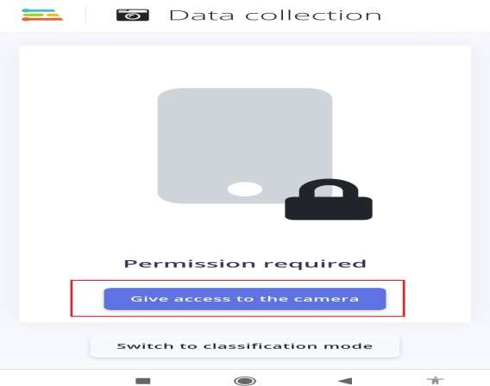
GIVE ACCESS TO THE CAMERA FOR CLICK IMAGES

Slide 17
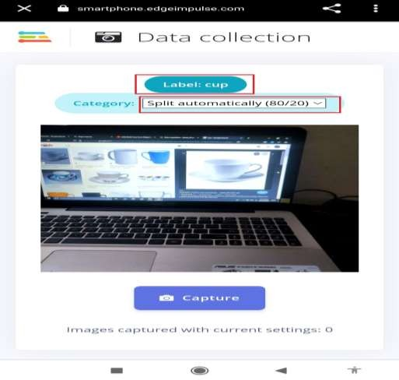
WRITE THE LABEL AND SELECT CATEGORY.
On the phone, change the Label to the name of the object you are going to take picture.
On your computer you will receive a message in the browser asking if you are building object detection model ? Answer NO

Slide 18
Pop message
On your computer you will receive a message in the browser asking if you are building object detection model ? Answer NO

Slide 19
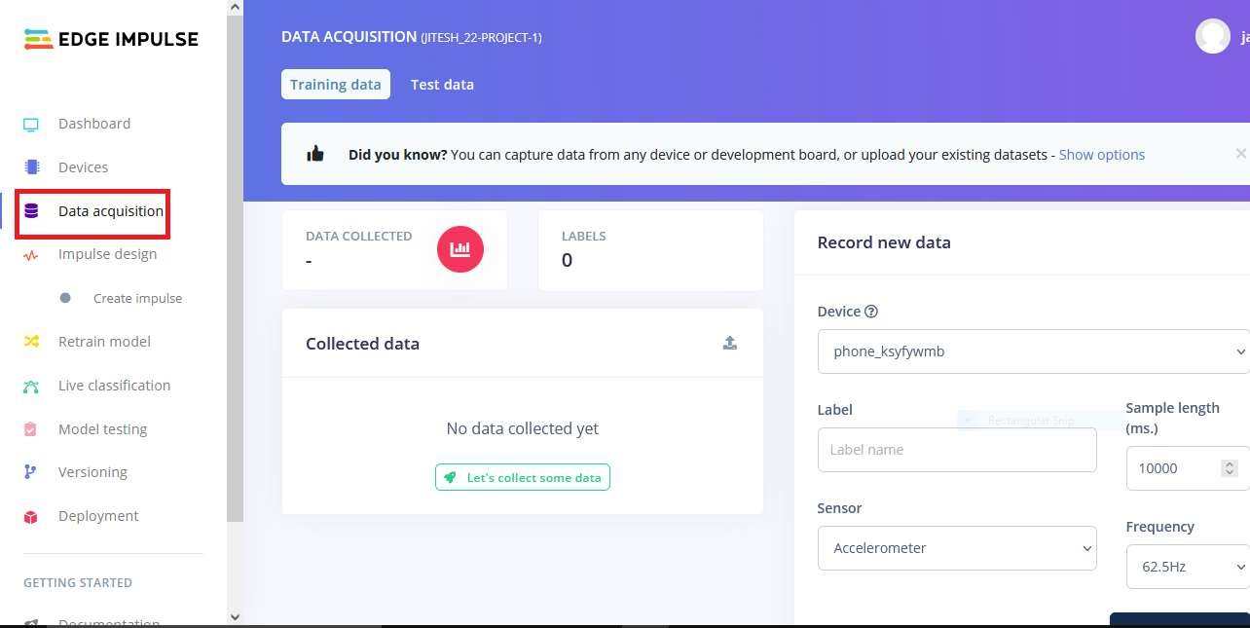
Click On Data Acquisition

Slide 20
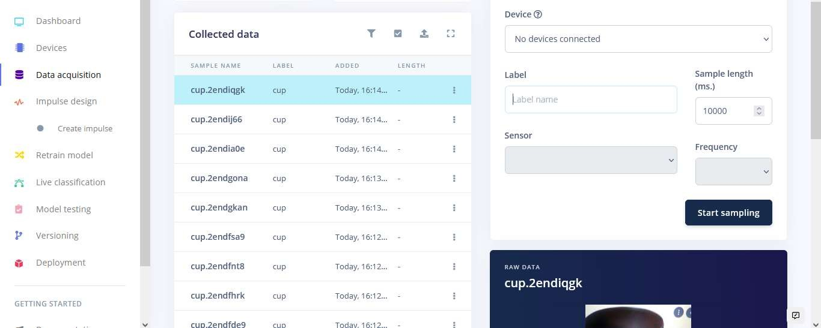
Now images are collecting
On your phone change the label name to say CUP, and then take 10 images of cup.

Slide 21
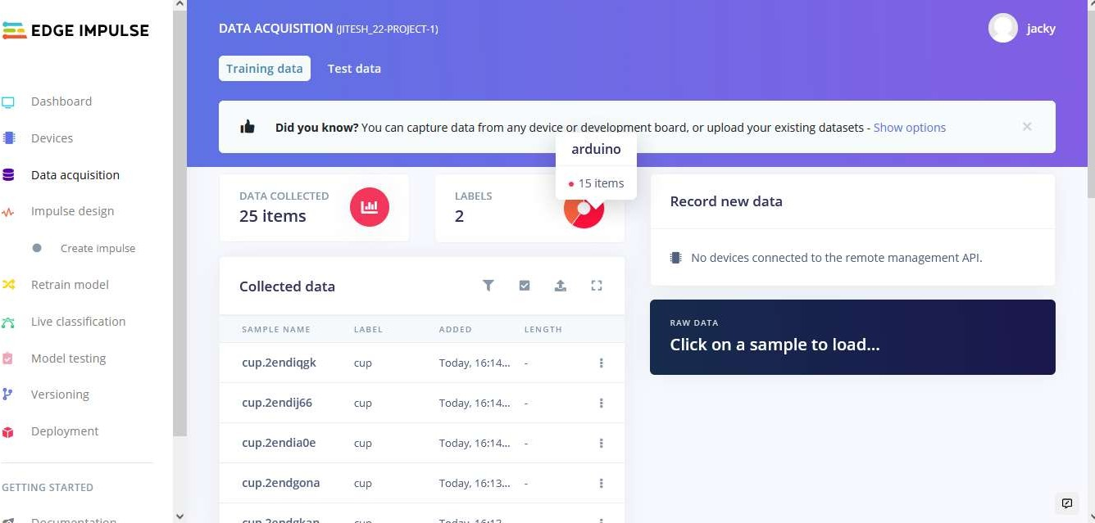
CHANGE THE LABEL IN MOBILE AND CLICK IMAGES
Now we take pictures of different object, say SPOON. First change the label on phone to SPOON, then take 10 pics of SPOON.

Slide 22
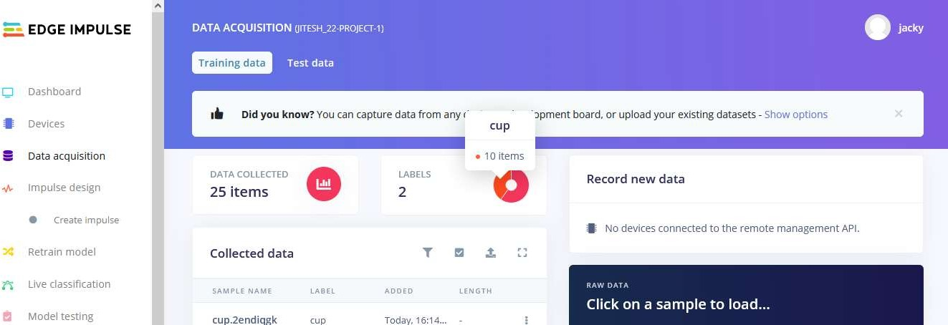
WE NEED DATA WITH 2 LABELS
Make sure that you have 90% data as training, and 10% as test data. You can change train data to test data by clicking on 3 little dots on LHS

Slide 23
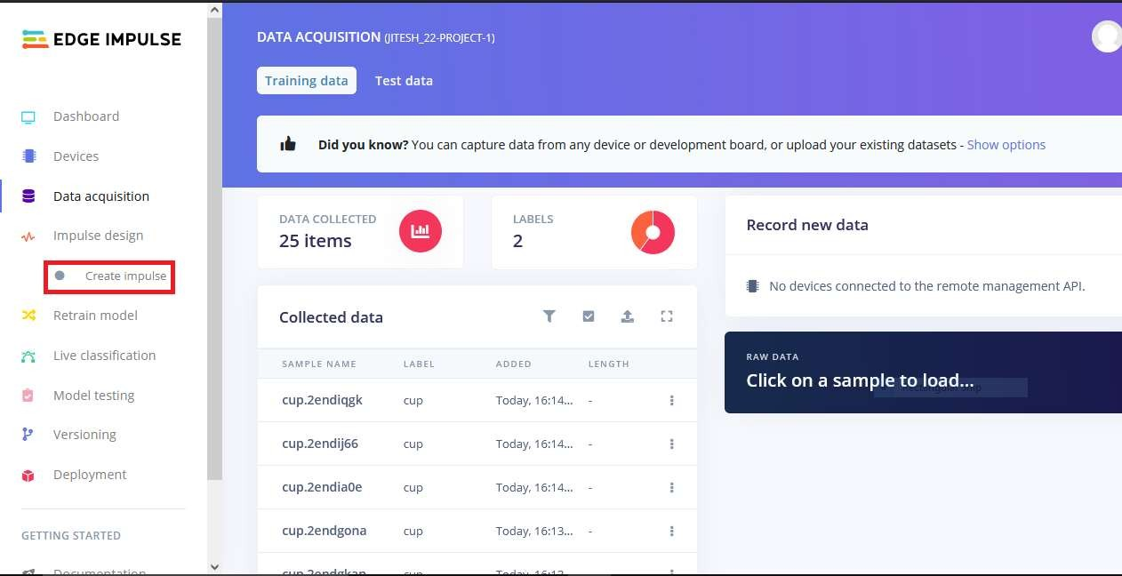
CLICK ON CREATE IMPULSE

Slide 24
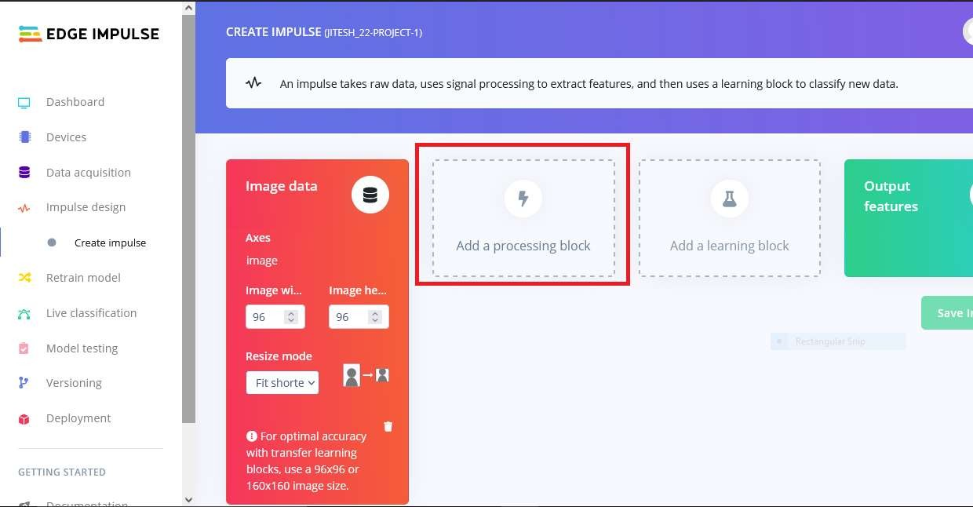
NOW ADD DATA PROCESSING BLOCK

Slide 25
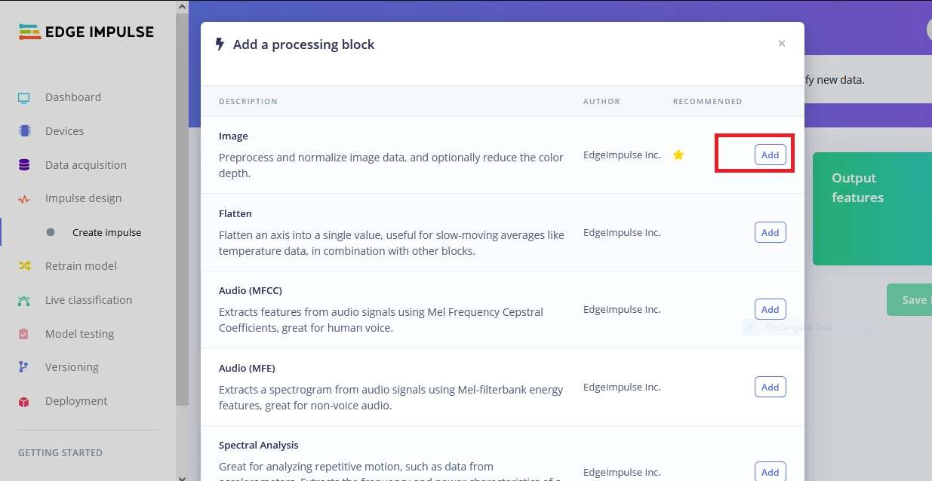
SELECT PROCESSING BLOCK

Slide 26
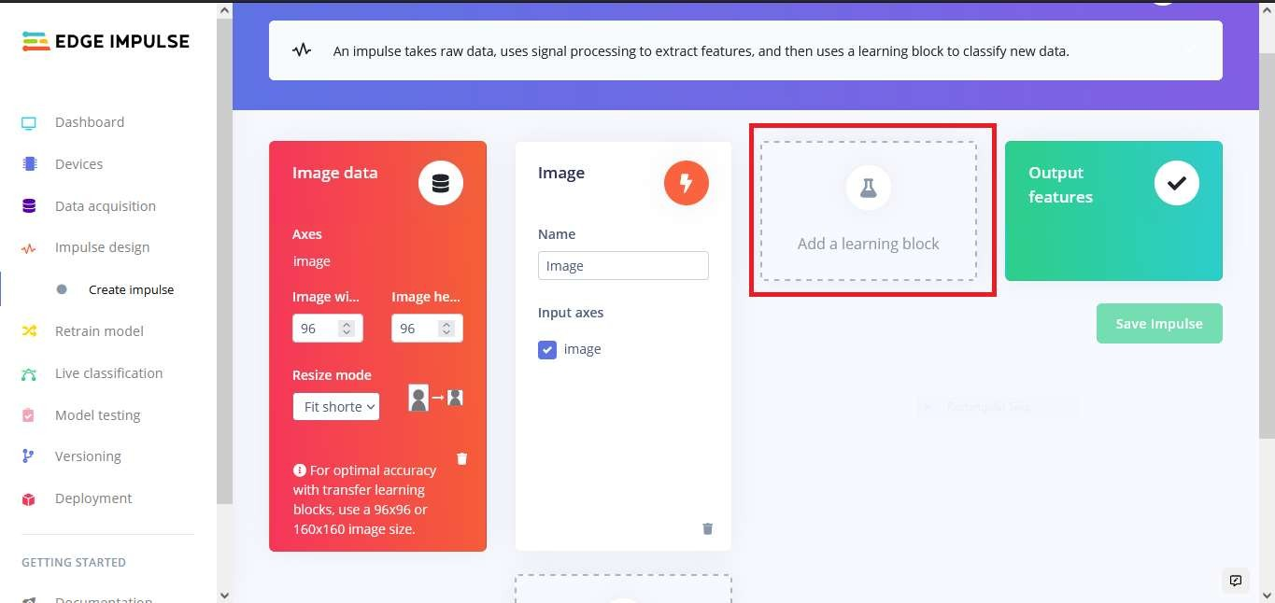
ADD LEARNING BLOCK

Slide 27
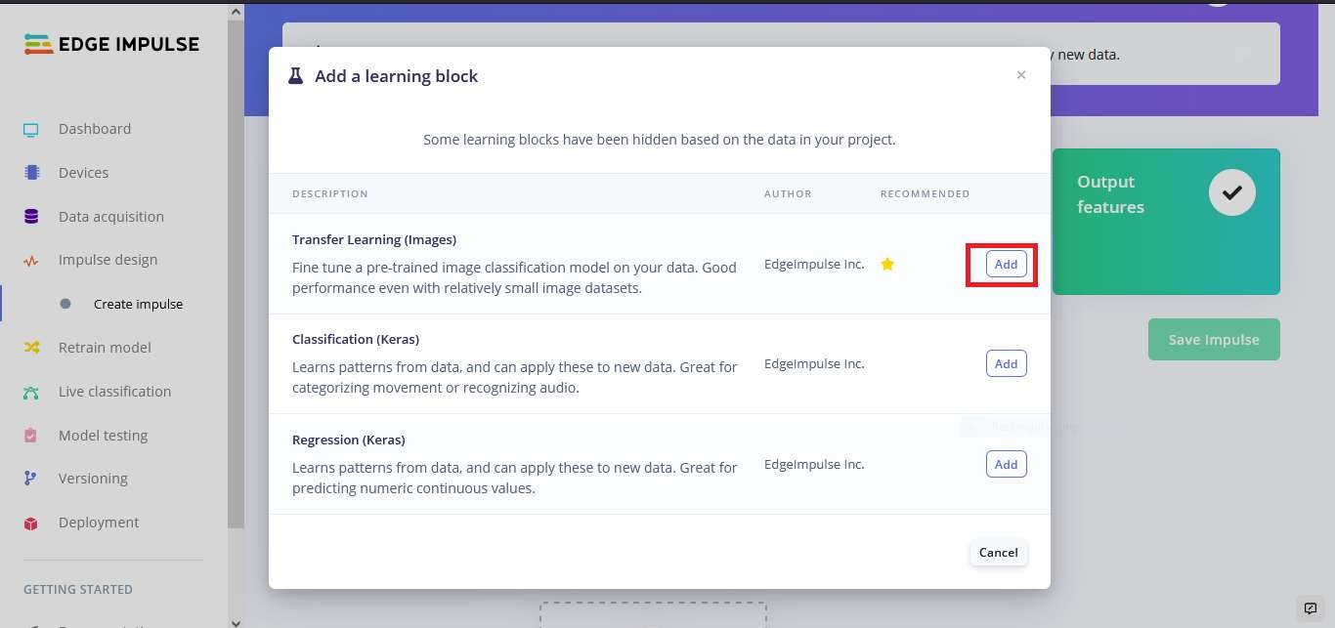
SELECT LEARNING BLOCK

Slide 28
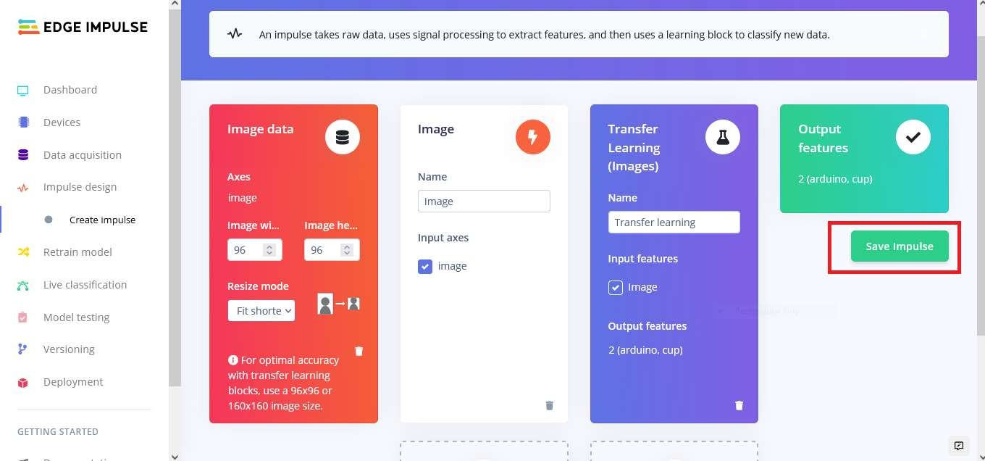
SAVE IMPULSE

Slide 29
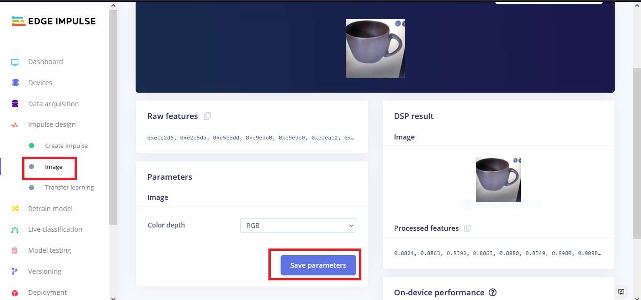
Click On Processing block And Then Click On Save parameters

Slide 30
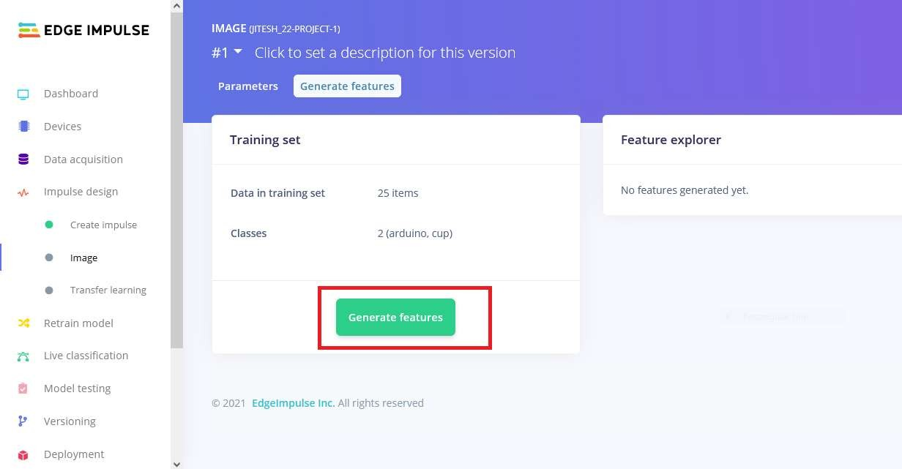
NOW CLICK ON GENERATE FEATURES

Slide 31
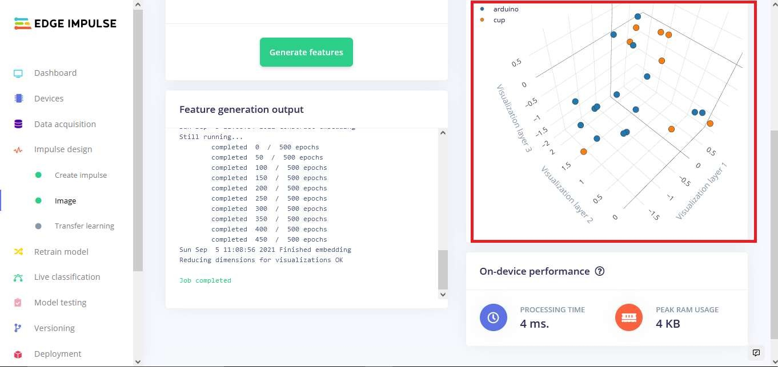
Graph of Features

Slide 32
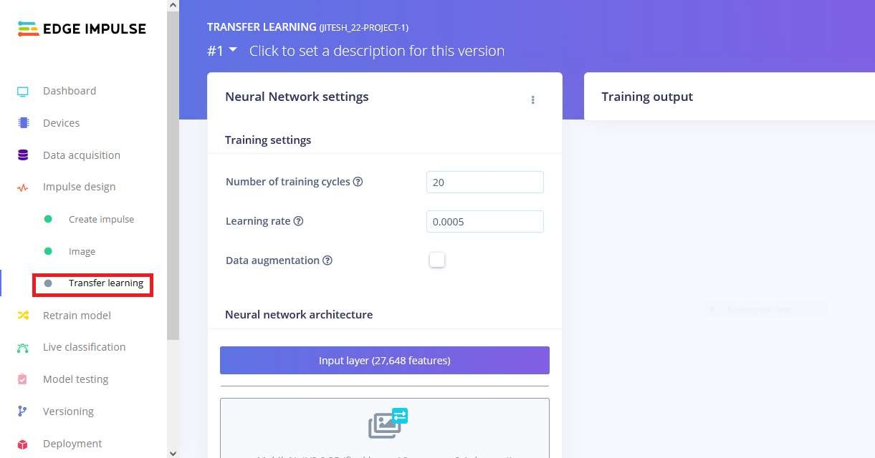
CLICK ON TRANSFER LERANING

Slide 33
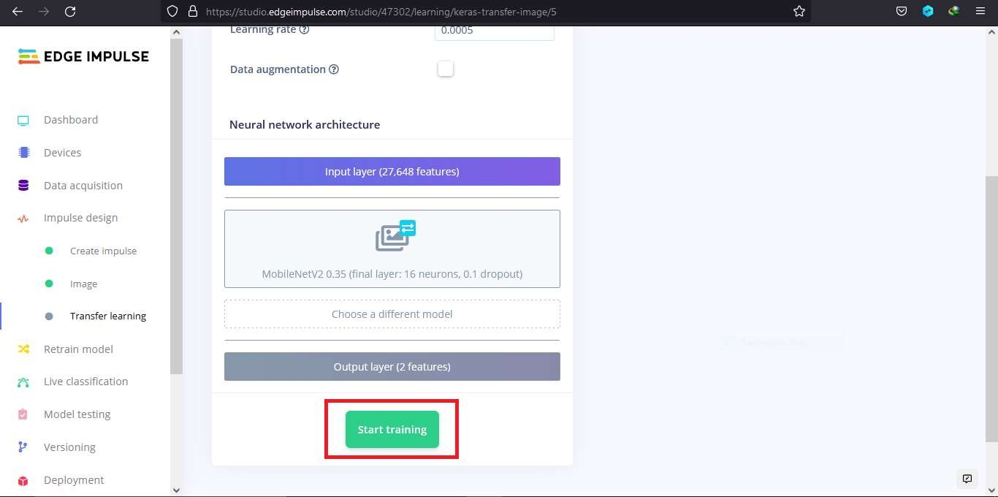
CLICK ON SAVE & START TRAINING

Slide 34
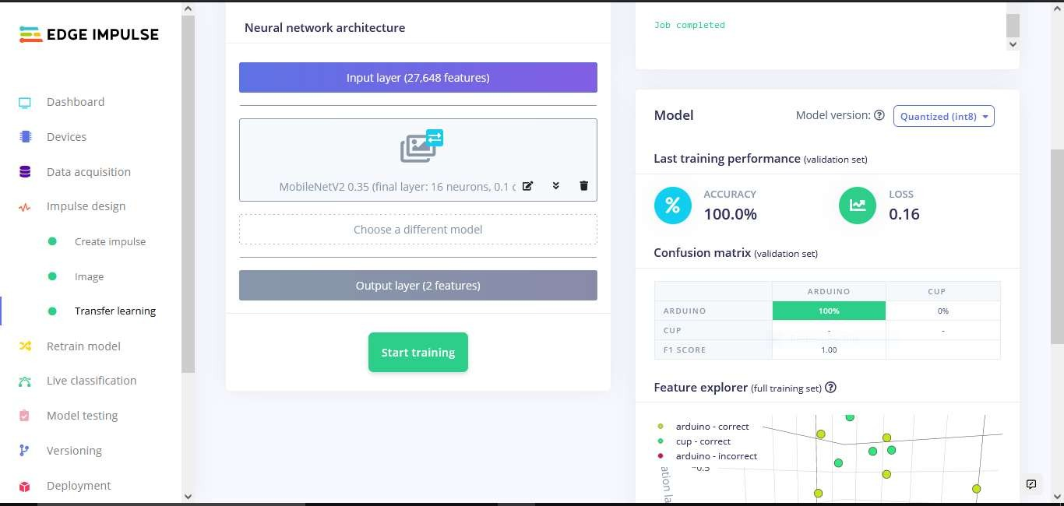

Slide 35
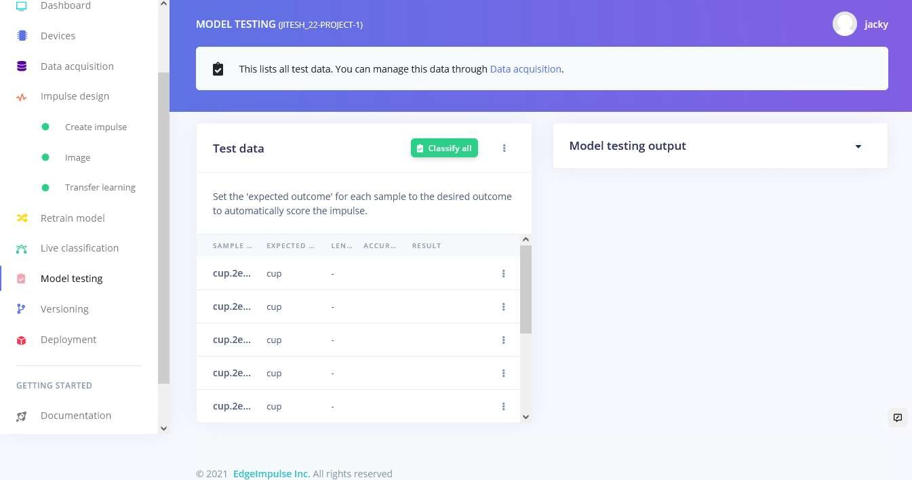
TESTING MODEL

Slide 36
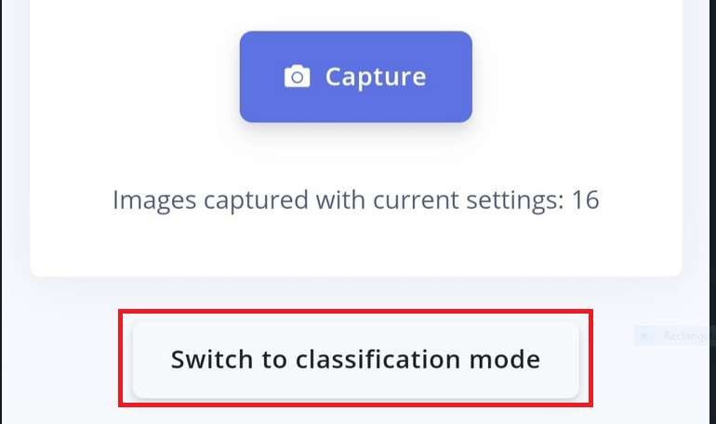
CLICK ON SWITCH TO CLASSFICATION MODE ON MOBILE

Slide 37
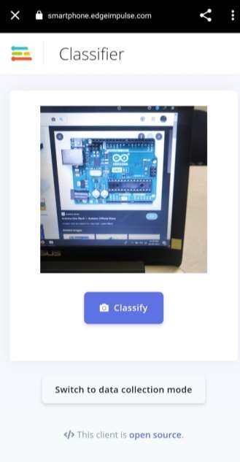
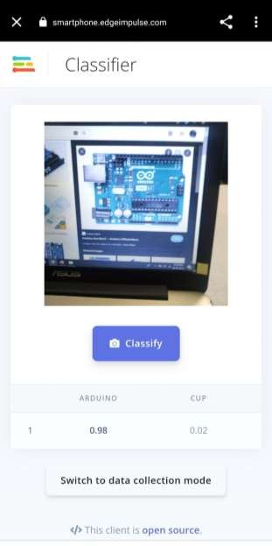
Classification Results

Slide 38







THANK YOU!
THANK YOU!
For Further Information:
https://tih.iitr.ac.in/
www.uniconvergetech.in
www.theiotacademy.co
You can also visit us at:

